Slide 1

STRATEGY OR LUCK ?
DSC 106 – FINAL VISUALIZATION PROJECT
TEAM TITANIC: SHIV SAKTHIVEL

Slide 2
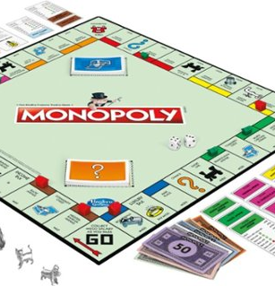
INTRODUCTION
Monopoly is a 2-8 player game with the objective to purchase properties around the board and bankrupt all the other players.
Movements across the board are made using the sum of 2 dice rolls, moving clockwise.
Along with dice rolls, landing on Chance or Community Chest also have the potential to move players.
Given these conditions, is a player’s performance in Monopoly purely dependent on luck or are there caveats to increase the likelihood of winning?

Slide 3
DATASET OVERVIEW
Data was collected using a computer-run simulation of a single player continuous Monopoly game lasting 60000 turns, with attributes encoding starting space, dice roll etc.
Supplementary datasets provide information on the mechanisms within the game: Buying property, Paying rent, Landing on Chance and Community Chest
Assumptions made for visualizations: The computer algorithm to generate data is unbiased, the data is only used to inform long-term trends in running the game and not specific actions (The observations in the dataset are not independent events).

Slide 4
THE FIRST QUESTION
Given that I am rolling dice and picking cards, which are random processes, am I equally likely to land on every space?
Approaching this question: Using the starting space attribute on every observations, we can find the individual frequency of turns in a single board space.
Specification: 1 Categorical Spatial Variable (Space Name) and 1 Numeric Variable (Frequency)
Bar charts are an obvious choice, but we would lose the spatial aspect of the board spaces.

Slide 5
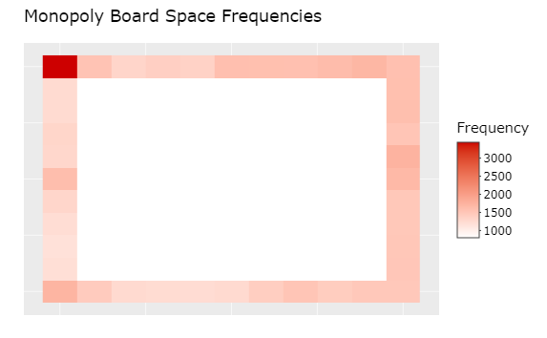
HEATMAP
By giving all the spaces x and y coordinates and making the squares in between blank, this heatmap was created to represent the game board. While this is just a picture, the visualization is interactive.

Slide 6
TECHNIQUES, PRICNIPLES,INSIGHTS
I added an interactive cursor feature to the heatmap to show the name of the Space and frequency.
Used red as the color to represent frequency, with a darker shade indicating greater frequency. This uses intensity within color as a method to abstract the frequency attribute.
The visualization task at hand is to locate the most frequent spots and compare two or more spaces, both of which a heatmap allows us to do easily.
Jail is by far the most frequented spot on the board, along with the railroads.
This makes sense because there exist extra paths within the game to lead to these.

Slide 7
MOVING
Now that we have established spot frequency, how about individual turns? If I am at a particular spot on the board, where do I land most often?
Intuition is that most of the time we roll the dice and so, there should exist connections to the spaces reachable by a movement of 2 to 12 spaces.
What do we have? Two Categorical Variables (Start and End) encoding an edge, One Numeric Variable (Number of times the connection is made)

Slide 8
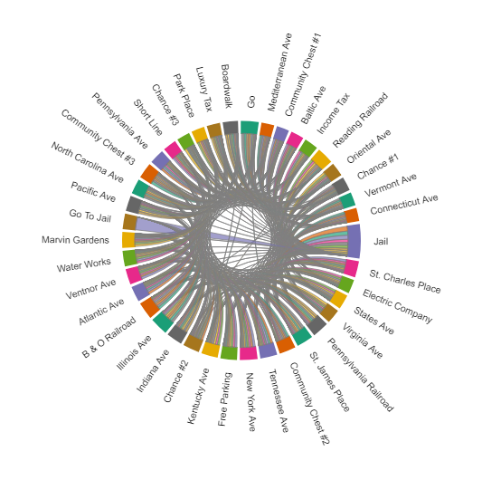
CHORD DIAGRAM
Each node represents a board space, and the thickness of the connection encodes the frequency of the move.
The most obvious connection is between Go To Jail and Jail.

Slide 9
TECHNIQUES, PRICNIPLES,INSIGHTS
The chord diagram is also interactive: Bringing a cursor over a connection reveals the directional flow between both nodes.
The nodes are in order of game space index and move clockwise as in the game board, establishing intuition for the user of the visualization. Like in the game board, the Jail and Go to Jail space also diametrically oppose each other in the visualization
The visualization task is to locate whether certain combinations of moves occur significantly more often.
The insight is that beyond the special moves in the game, flows are uniform.

Slide 10
PICKING CARDS
After noticing the anomalies in movement patterns, the logical question to ask is whether the inclusion of Chance and Community Chest have disproportionate or significant effects on the game.
Although both actions involve picking cards, they are mechanically different: Community Chest does not cause the player to move off the square, while Chance cards can move players around the board.
Looking just for monetary gain, there are three spots on the board labelled Community Chest. Given that picking cards is a random action, would I be receiving equally profitable outcomes on all three?
What do I have? 1 Categorical Variable (Community Chest #) and 1 Numeric Variable (Expected Amount)

Slide 11
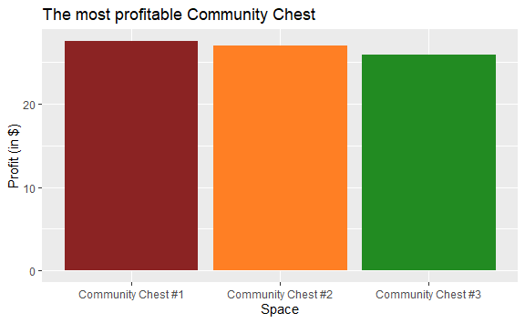
SIMPLE BAR PLOT
Information encoded is not complex or spatial. So, a bar plot is appropriate. The colors of the bars correspond to the color of the group they are in, establishing context.

Slide 12

WHERE WILL CHANCE TAKE ME?
Taking advantage of the movement aspect of landing on Chance, it is reasonable to investigate the different spaces to which it leads. The subset of the data used here will be those moves initiating at Chance #1 that must require movement to another square.
What do we have? A fixed source node ( Chance #1) and multiple destination nodes and 1 numeric variable (Frequency of connection)
A chord diagram is appropriate for complex networks but for this structure, another visualization provides more clarity.

Slide 13
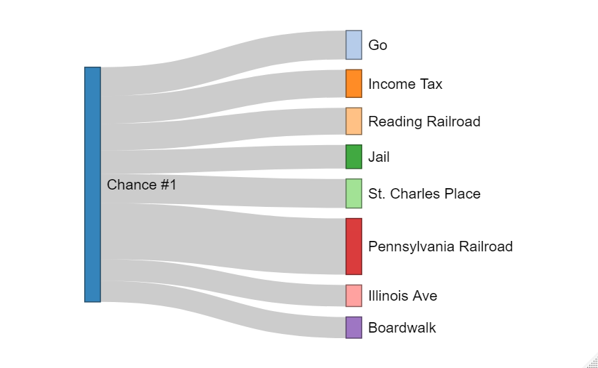
SANKEY DIAGRAM
Simplistic representation of flow to different spaces reachable by a Chance Card.
The flow to Pennsylvania Railroad is almost twice every other space.
This is an important insight because there are two cards leading to this space compared to the one for every other space.
In the end, all the outcomes largely do balance out.

Slide 14
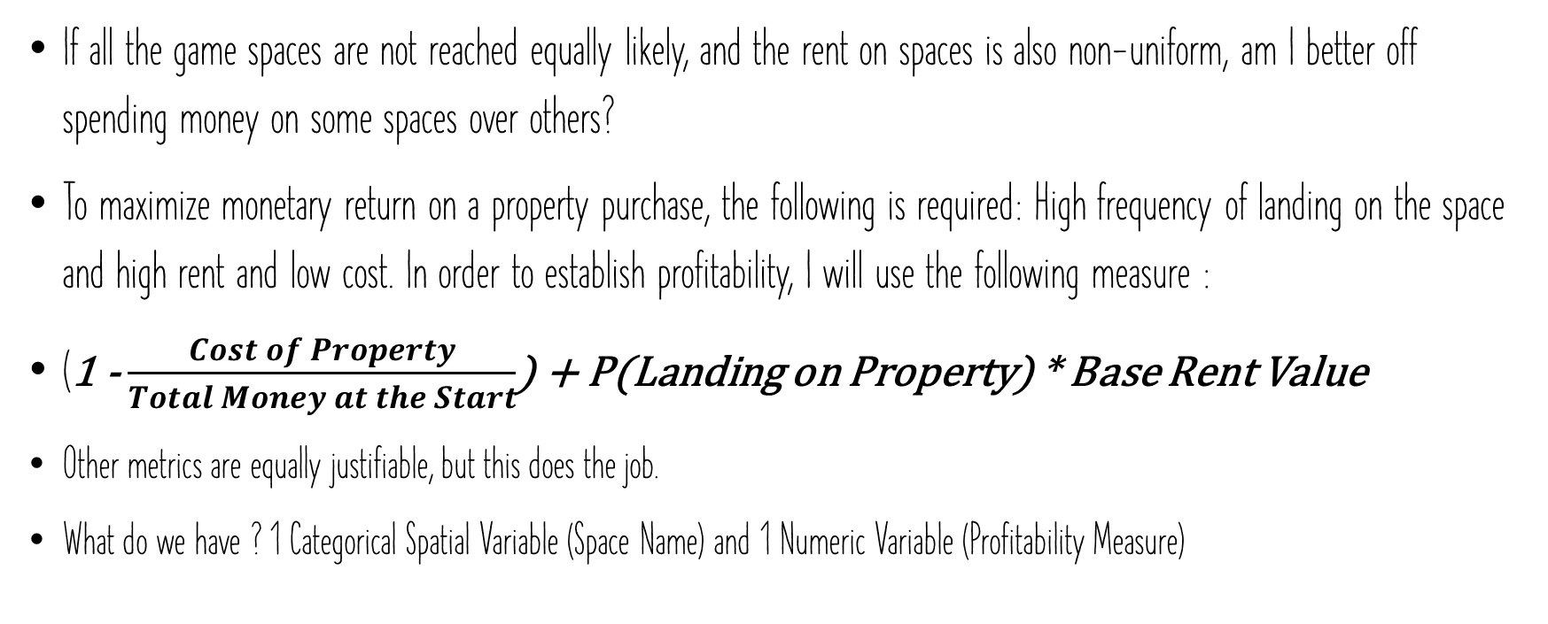
THE MILLION DOLLAR QUESTION
If all the game spaces are not reached equally likely, and the rent on spaces is also non-uniform, am I better off spending money on some spaces over others?
To maximize monetary return on a property purchase, the following is required: High frequency of landing on the space and high rent and low cost. In order to establish profitability, I will use the following measure :
(1 - $\frac{Cost of Property}{Total Money at the Start}$) + P(Landing on Property) * Base Rent Value
Other metrics are equally justifiable, but this does the job.
What do we have ? 1 Categorical Spatial Variable (Space Name) and 1 Numeric Variable (Profitability Measure)

Slide 15
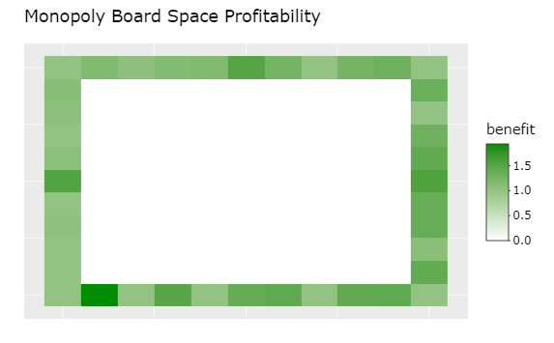
ANOTHER HEATMAP
Boardwalk stands out as the most profitable spot on the board, despite its high cost. Why?
It is also reachable by Chance.

Slide 16
INVESTIGATION OVERVIEW
There exist so many ways to get to Jail, that it is by far the space most likely to be landed on.
The railroads and Boardwalk are the properties to aim for due to their high rent/cost ratio and high frequency.
While more expensive properties put the players at risk, they are also more profitable in the long run.
But the most significant insight is that: The network formed between the spaces on the board are largely uniform and conform to the probability distributions given the game rules, when played for a reasonably long time.

Slide 17
CHALLENGES
Too many uncertainties:
Monopoly largely depends on the effects that the actions of a player has on everyone else. While this simulation allows us to establish the long-term properties of the game, the reality of the game is much more volatile. For this dataset, there is no way to combat this aspect.
1
Technical Difficulties:
While interactive visualization libraries on python and R backed by JavaScript's D3 are incredibly powerful and customizable, the learning curve is huge for a beginner. So, I was limited in the design choices made in these visualizations.
2

Slide 18
INTERACTIVE VISUALIZATION VERSIONS
C:\Users\shivs\OneDrive\Documents\ggplotlyHeatmap.html
C:\Users\shivs\OneDrive\Documents\chord_interactive.html
C:\Users\shivs\OneDrive\Documents\sankeyChance.html
C:\Users\shivs\OneDrive\Documents\moneyHeatmap.html

